Slide 1
Mini-Web Agent for Choosing the Right Product
University of Technology (Yatanarpon Cyber City)
Faculty of Information and Communication Technology
Department of Information Science
Second Seminar
Supervised by
Dr. Nandar Win Min
Presented by
Thaw De Zin (6IST-66)

Slide 2
Outline
Abstract
Objectives
Scope of Thesis
Field Background
System Design
Expected Output
Future work
Conclusion

Slide 3
Abstract
Web scraping is an automated tool for finding and extracting data from on-line sources.
It is also referred to as automated data collection, web extracting, web crawling, or web content mining.
It commonly used in price comparison, president election, brand promoting and miscellaneous purposes.
The proposed system is to develop web agent for people to choose which products they should buy.
The web crawler is used to get information about products across the web resources.
In this system, during crawling the entire website pages/links, TF-IDF will be used to filter the pages/links about the product (laptop).
The system will give 3 most relevant laptops according to the user input using KNN algorithm.

Slide 4
Objectives
To understand how a crawler and search engine works
To study web scraping use cases and applied areas
To develop simple web scraping tool for choosing suitable product from e-commerce websites.
To help people in finding the products that they want in a short period of time.

Slide 5
Scope of Thesis
This system crawl maximum of 3 websites.
http://www.linnonlinestore.com
http://www.royalsmartmm.com
http://www.sln-myanmar.com
Frequently changed layout of website will not be processed.
The working product is only specific one. (Example., Laptops)

Slide 6
Field Background
Web Crawling
Crawling
Indexing (TF*IDF)
Web Scraping
Ranking (HTML Parsing)
Classification
K-Nearest Neighbors

Slide 7
K-Nearest Neighbors
The K-nearest neighbors (KNN) algorithm is a type of supervised machine learning algorithms.
KNN is extremely easy to implement in its most basic form, and yet performs quite complex classification tasks.
It doesn't have a specialized training phase.
It uses all of the data for training while classifying a new data point or instance.
KNN doesn't assume anything about the underlying data.
This is an extremely useful feature since most of the real world data doesn't really follow any theoretical assumption.

Slide 8
K-Nearest Neighbors
Pros
Cons
It is extremely easy to implement.
It requires no training prior to making real time predictions.
Since the algorithm requires no training before making predictions, new data can be added seamlessly.
There are only two parameters required to implement KNN i.e. the value of K and the distance function.
The KNN algorithm doesn't work well with high dimensional data because with large number of dimensions, it becomes difficult for the algorithm to calculate distance in each dimension.
The KNN algorithm has a high prediction cost for large datasets. This is because in large datasets the cost of calculating distance between new point and each existing point becomes higher.

Slide 9
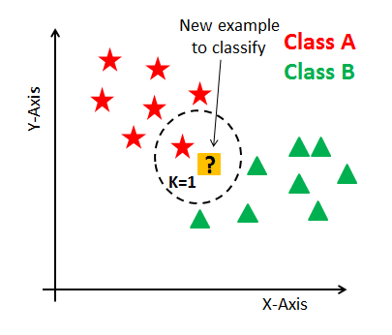
How does KNN algorithm work?
In KNN, K is the number of nearest neighbors.
The number of neighbors is the core deciding factor.
K is generally an odd number if the number of classes is 2. When K=1, then the algorithm is known as the nearest neighbor algorithm.
This is the simplest case. Suppose P1 is the point, for which label needs to predict. First, you find the one closest point to P1 and then the label of the nearest point assigned to P1.

Slide 10
How does KNN algorithm work? (Cont’d)
Suppose P1 is the point, for which label needs to predict.
First, find the k closest point to P1 and then classify points by majority vote of its k neighbors.
Each object votes for their class and the class with the most votes is taken as the prediction.
For finding closest similar points, you find the distance between points using distance measures.
KNN has the following basic steps:
Calculate distance
Find closest neighbors
Vote for labels

Slide 11
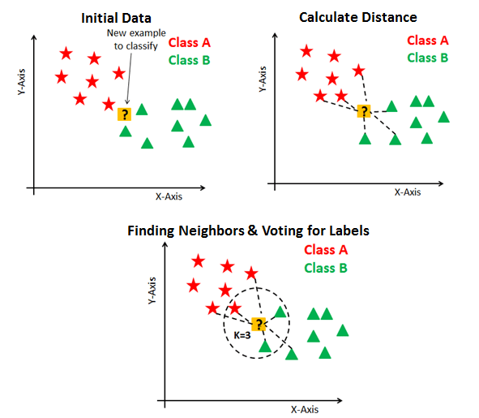
How does KNN algorithm work? (Cont’d)
Image Source : https://www.datacamp.com

Slide 12
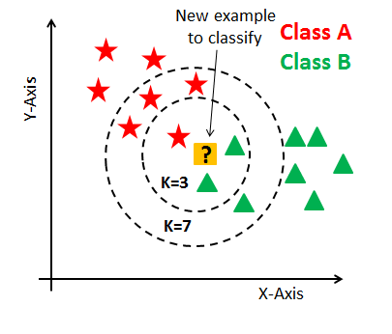
Number of neighbors
The number of neighbors(K) in KNN is a hyperparameter that you need choose at the time of model building. You can think of K as a controlling variable for the prediction model.
Research has shown that no optimal number of neighbors suits all kind of data sets. Each dataset has its own requirements.
Research has also shown that a small amount of neighbors are most flexible fit which will have low bias but high variance and a large number of neighbors will have a smoother decision boundary which means lower variance but higher bias.
Generally, choose as an odd number if the number of classes is even.

Slide 13
System Design for Crawling
Start
Pages/
Links
Crawl entire 3 websites
Filter the Laptop pages using IT-IDF
Extract laptop’s features
Normalization for
laptop entry
Normalized laptop list
End

Slide 14
System Design for Searching
Start
Laptop’s feature
Determine relevant laptop by using K-Nearest Neighbors
Normalized laptop list
Display 3 relevant laptops
End

Slide 15
User Input Limitations
Specification
Price
Brand
Available format!
S+B
S+P
B+P
B+S+P is not available

Slide 16
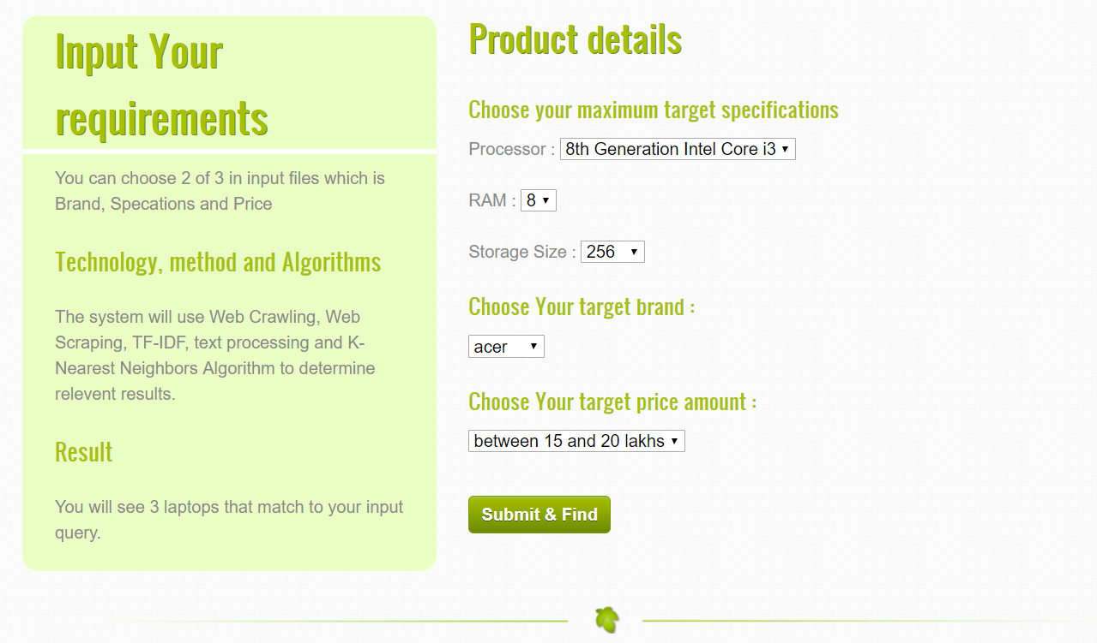
User Input

Slide 17
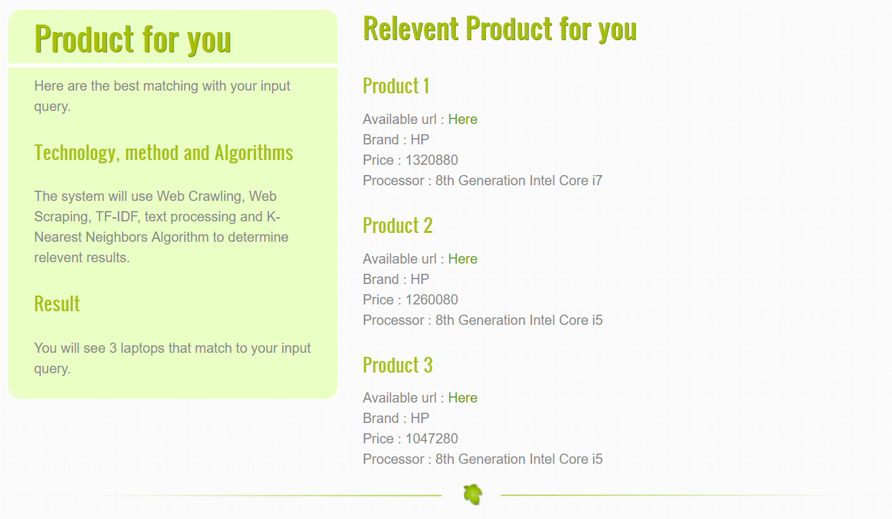
Result

Slide 18
Expected Output
The mini-web agent can support the people to choose which products they should buy across the web resources.
It also provide functionality to filter too many relevant results from searching.

Slide 19
Future Work
Applying K-NN algorithm to classify products from normalized results.
Complete implementation of Mini Web Agent that is crawling, scraping and recommendation.
Determine 3 relevant laptops to display.

Slide 20
Conclusion
This system will give too much knowledge about web scraping, web crawlers and how to migrate them with classification methods.
The system helps to understand how Search Engine works.
The user can get the information about the suitable product during a short period of time without the need for visiting too many websites.
User can also have advantages from KNN algorithm. With the help of the algorithm, user can save time and fuzzy choosing because the most three relevant items are showed.

Slide 21
Thank You

